Slide 1


Ahmed Nasreldeen
16/10/2023

Slide 2

Outline
Executive Summary
Introduction
Methodology
Results
Conclusion
Appendix

Slide 3
Executive Summary
Summary of methodologies
This project follows these steps:
Data Collection.
Data Wrangling.
Exploratory Data Analysis.
Interactive Visual Analytics
Predictive Analysis
Summary of all results
Project outputs:
Exploratory Data Analysis.
Geospatial Analysis.
Interactive Dashboard
Predictive Analysis Of Classification Models.

Slide 4

Introduction
SpaceX launches Falcon 9 rockets at a cost of around$62m. This is considerably cheaper than other providers (which usually cost upwards of $165m), and much of the savings are because SpaceX can land, and then re-use the first stage of the rocket
if we can make predictions on whether the first stage will land, we can determine the cost of a launch, and use this information to assess whether or not an alternate company should bid and SpaceX for a rocket launch.

Slide 5

Section 1

Slide 6
Methodology
Executive Summary
Data collection methodology:
Using SpaceX REST API to GET Requests.
Web Scraping.
Perform data wrangling
Using some helping methods like:
.fillna() :to fill nulls cells with measurements of central tendency.
.count_values() : to show frequency of event like:
Number of Launches on each site
Perform exploratory data analysis (EDA) using visualization and SQL
Perform interactive visual analytics using Folium and Plotly Dash
Perform predictive analysis using classification models
Using Scikit-Learn to:
Pre-Proces the data
Split data
Find Hyper-Parameter Using Grid SearchCV
Assessing Accuracy Of each Model.
Confusion matrices for each classification algorithm

Slide 7
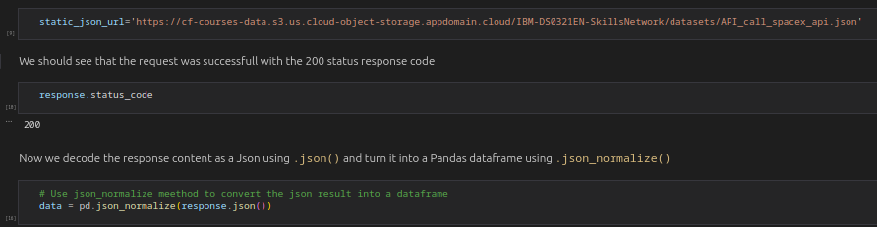
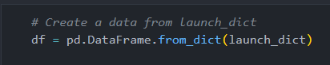
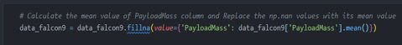
Data Collection – SpaceX API
Make GET Request to retrieve data From API
Covert response to .json then to Pandas Data Frame.
Using SpaceX API to retrieve data about launches, including information about rocket used, payload delivered, launch specification, landing specification and landing outcome.
Using custom logic to clean the data​
Define lists to store data in​
Call custom function to fill these lists with retrieved data​
Use these lists as values in dictionary to build Dataset
Create pandas data frame form dataset
Filter dataframe to only include falcon9
reset flightnumber column
Replace null values with mean of columns
GitHub

Slide 8
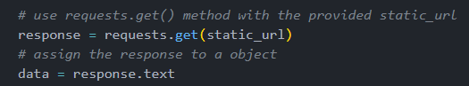
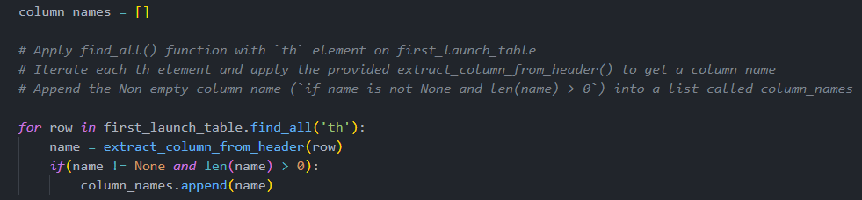
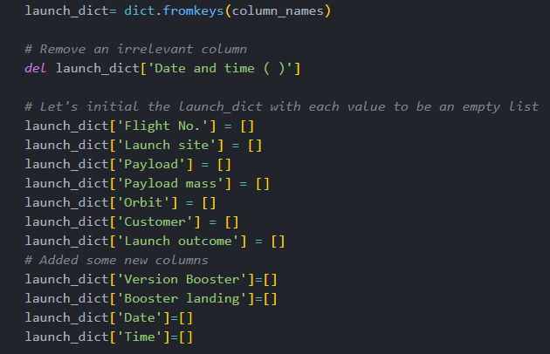
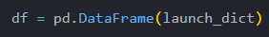
1
Data Collection - Scraping
Web Scraping to collect Falcon9 historical launch records From Wikipedia page
Make GET Request to get HTML Page
Create a Beautiful Soup Object From response
Find all tables within html page
Collect all column header names from tables
Use column names as key to build Dictionary
use custom function to sparse all tables to fill dictionary values
Convert Dictionary to Pandas DataFrame
GitHub

Slide 9
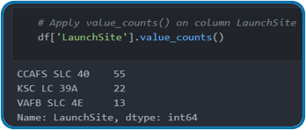
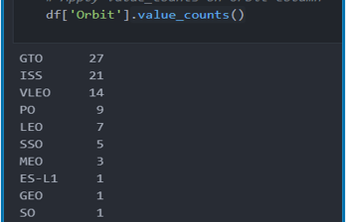
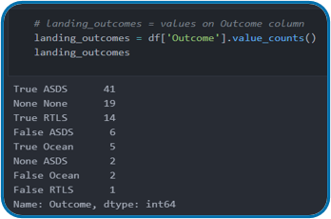
Data Wrangling
Context:
The SpaceX dataset contains several Space X launch facilities, and each location is in the LaunchSite column.
Each launch aims to a dedicated orbit, and some of the common orbit types are shown in the figure below. The orbit type is in the Orbit column.
Initial Data Exploration:
Using the .value_counts() method to determine the following:
Number of launches on each site
Number and occurrence of each orbit
Number and occurrence of landing outcome per orbit type
GitHub

Slide 10
EDA with Data Visualization
Scatter Charts
Bar Charts
Line Charts
Scatter Chart Were produced to visualize the relationship between:
Flight Number And Launch Site
Payload And Launch Site
Orbit Type And Flight Number
Orbit Type And Payload
Scatter Charts are useful to observe the relationships between to numeric variables
Bar Chart was produced to visualize the relationships between:
Success Rate and Orbit Type
Bar Chart are used to compare a numerical variable to a categorical variable
Line Charts were produced to visualize the relationships between:
Success Rate and Year
Line Chart contain numerical values on both axes and are general used to show the changes of variable over time.
GitHub

Slide 11
EDA with SQL
To gather some information about dataset, some SQL queries were used
=> Queries like:
Display the names of the unique launch sites in the space mission
Display 5 records where launch sites begin with the string ‘CCA’
Display the total payload mass carried by boosters launched by NASA (CRS)
Display the average payload mass carried by booster version F9 v1.1
List the date when the first successful landing outcome on a ground pad was achieved
List the names of the boosters which had success on a drone ship and a payload mass between 4000 and 6000 kg
List the total number of successful and failed mission outcomes
List the names of the booster versions which have carried the maximum payload mass
List the failed landing outcomes on drone ships, their booster versions, and launch site names for 2015
Rank the count of landing outcomes (such as Failure (drone ship) or Success (ground pad)) between the date 2010-06-04 and 2017-03-20, in descending order
GitHub

Slide 12
Build an Interactive Map with Folium
The following steps were taken to visualize the launch data on an interactive map
Mark all launch sites on a map
Initialize the map using a folium Map object
Add folium circle and folium marker for each launch site on the map
Mark the success/failed launches for each site on a map
Assign color green for successful class and red for failed class to its marker
Since many launch sites have the same coordinates, it make sense to cluster them together.
To put the launches into clusters, add the folium.Marker to MarckerClusters object
Calculate the distance between a launch site to it’s proximities
To explore the proximities of launch sites, calculations of distances between points can be made using the Lat and Long values.
After marking a point using the Lat and Long values, create a folium.Marker object to show the distance.
To display the distance line between two points, draw a folium.PolyLine and add this to the map.
GitHub

Slide 13
Build a Dashboard with Plotly Dash
The following plots were added to a Plotly Dash dashboard to have an interactive visualisation of the data:
Pie chart (px.pie()) showing the total successful launches per site
This makes it clear to see which sites are most successful
The chart could also be filtered (using a dcc.Dropdown() object) to see the success/failure ratio for an individual site
Scatter graph (px.scatter()) to show the correlation between outcome (success or not) and payload mass (kg)
This could be filtered (using a RangeSlider() object) by ranges of payload masses
It could also be filtered by booster version
GitHub

Slide 14
Predictive Analysis (Classification)
Model Development
Model Evaluation
Finding The Best Model
Data set Preparation to model
Load dataset
Perform pre-processing to data
Split data into training and test data
Decide which ML algorithms are suitable
For each chosen algorithm
Create dictionary parameter and GridSearchCV
Fit Object to Parameter
Use Training dataset to Train model
For each chosen algorithm
Using the output GridSearchCV Object:
Check the tuned hyperparameters
Check the accuracy (score and best_score_)
Plot and examine the Confusion Matrix
Review the accuracy scores for all chosen algorithms
The model with the highest accuracy score is determined as the best performing model
GitHub

Slide 15
Results
Exploratory data analysis results
Interactive analytics demo in screenshots
Predictive analysis results

Slide 16

Section 2

Slide 17
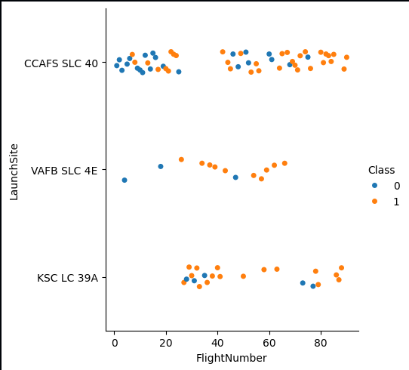
Flight Number vs. Launch Site
The scatter plot of Launch Site vs. Flight Number shows that:
As the number of flights increases, the rate of success at a launch site increases.
Most of the early flights (flight numbers < 30) were launched from CCAFS SLC 40, and were generally unsuccessful.
The flights from VAFB SLC 4E also show this trend, that earlier flights were less successful.
No early flights were launched from KSC LC 39A, so the launches from this site are more successful.
Above a flight number of around 30, there are significantly more successful landings (Class = 1).

Slide 18
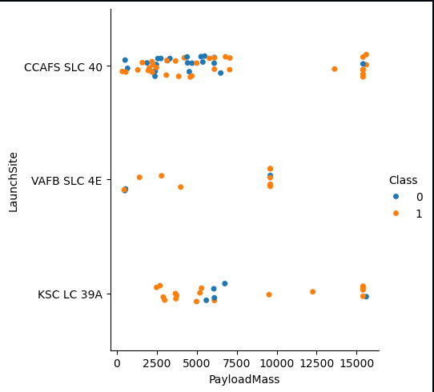
Payload vs. Launch Site
The scatter plot of Launch Site vs. Payload Mass shows that:
Above a payload mass of around 7000 kg, there are very few unsuccessful landings, but there is also far less data for these heavier launches.
There is no clear correlation between payload mass and success rate for a given launch site.
All sites launched a variety of payload masses, with most of the launches from CCAFS SLC 40 being comparatively lighter payloads (with some outliers).

Slide 19
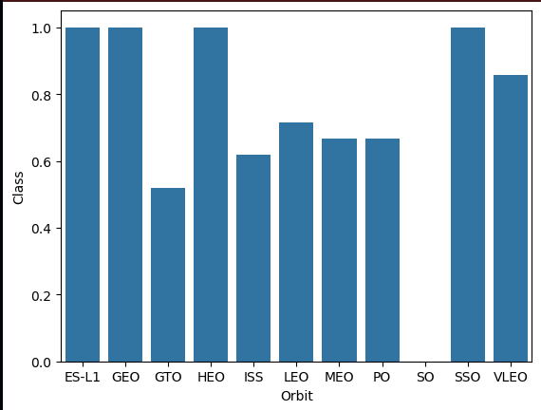
Success Rate vs. Orbit Type
The bar chart of Success Rate vs. Orbit Type shows that the following orbits have the highest (100%) success rate:
ES-L1 (Earth-Sun First Lagrangian Point)
GEO (Geostationary Orbit)
HEO (High Earth Orbit)
SSO (Sun-synchronous Orbit)
The orbit with the lowest (0%) success rate is:
SO (Heliocentric Orbit)

Slide 20
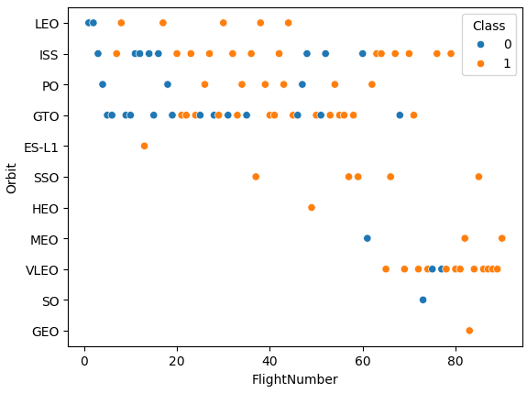
Flight Number vs. Orbit Type
This scatter plot of Orbit Type vs. Flight number shows a few useful things that the previous plots did not, such as:
The 100% success rate of GEO, HEO, and ES-L1 orbits can be explained by only having 1 flight into the respective orbits.
The 100% success rate in SSO is more impressive, with 5 successful flights.
There is little relationship between Flight Number and Success Rate for GTO.
Generally, as Flight Number increases, the success rate increases. This is most extreme for LEO, where unsuccessful landings only occurred for the low flight numbers (early launches).

Slide 21
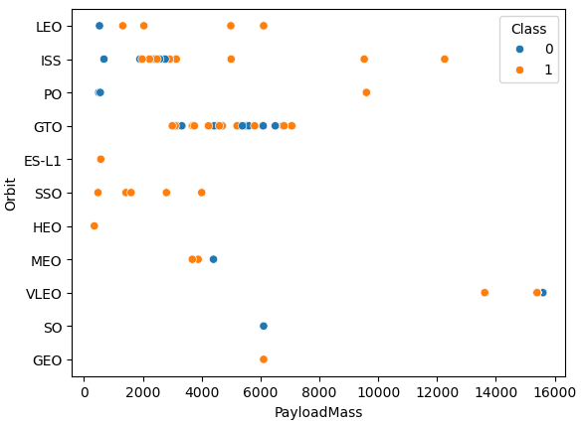
Payload vs. Orbit Type
This scatter plot of Orbit Type vs. Payload Mass shows that:
The following orbit types have more success with heavy payloads:
PO
ISS
LEO
For GTO, the relationship between payload mass and success rate is unclear.
VLEO (Very Low Earth Orbit) launches are associated with heavier payloads, which makes intuitive sense.

Slide 22
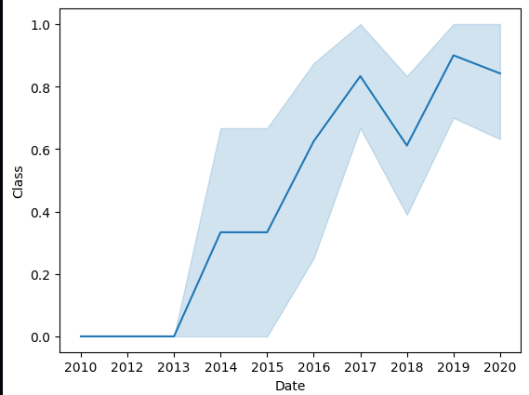
Launch Success Yearly Trend
The line chart of yearly average success rate shows that:
Between 2010 and 2013, all landings were unsuccessful (as the success rate is 0).
After 2013, the success rate generally increased, despite small dips in 2018 and 2020.
After 2016, there was always a greater than 50% chance of success.

Slide 23
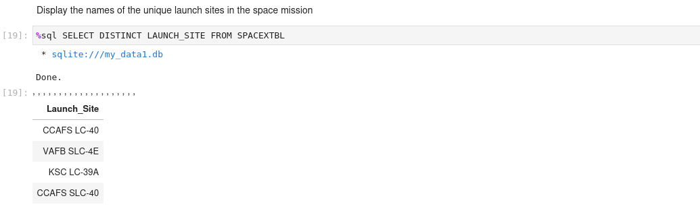
All Launch Site Names
The word DISTINCT return only unique values from Launch Site column of the SPACEXTBL table.

Slide 24
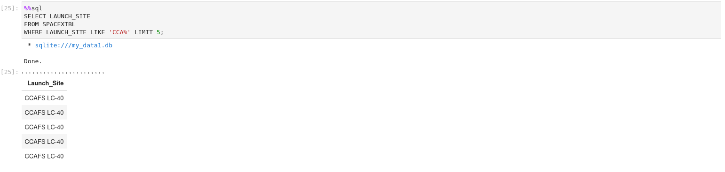
Launch Site Names Begin with 'CCA'
LIKE keyword is used with the wild card 'CAA%' to retrieve the values beginning with 'CCA'
LIMIT 5 fetch only five records

Slide 25
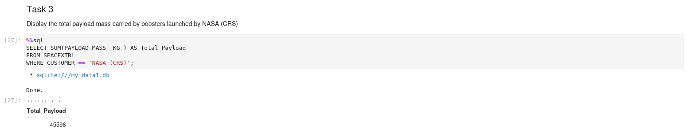
Total Payload Mass
SUM keyword is used to calculate the values of 'PAYLOAD_MASS_KG_' column
With condition CUSTOMER is equal 'NASA (CRS)'

Slide 26
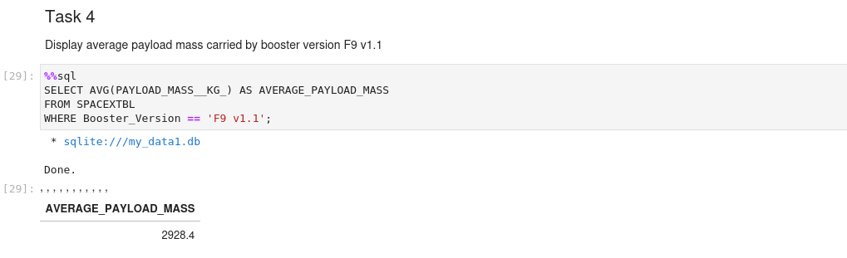
Average Payload Mass by F9 v1.1
The AVG keyword is used to calculate the average of the PAYLOAD_MASS__KG_ column, and the WHERE keyword (and the associated condition) filters the results to only the F9 v1.1 booster version.

Slide 27
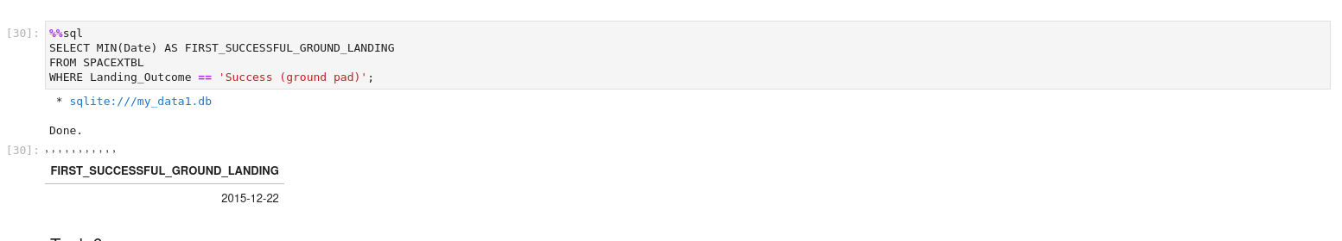
First Successful Ground Landing Date
The MIN keyword is used to calculate the minimum of the DATE column, i.e. the first date, and the WHERE keyword (and the associated condition) filters the results to only the successful ground pad landings.

Slide 28
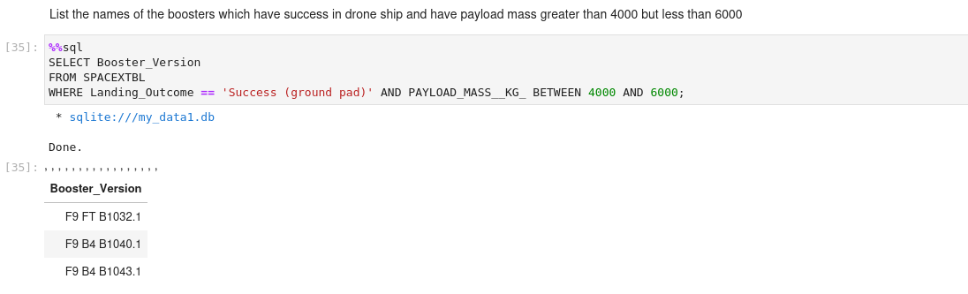
Successful Drone Ship Landing with Payload between 4000 and 6000
The WHERE keyword is used to filter the results to include only those that satisfy both conditions in the brackets (as the AND keyword is also used). The BETWEEN keyword allows for 4000 < x < 6000 values to be selected.

Slide 29
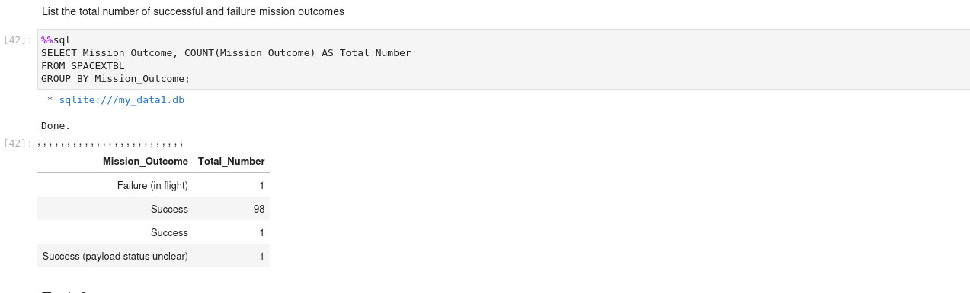
Total Number of Successful and Failure Mission Outcomes
The COUNT keyword is used to calculate the total number of mission outcomes, and the GROUPBY keyword is also used to group these results by the type of mission outcome.

Slide 30
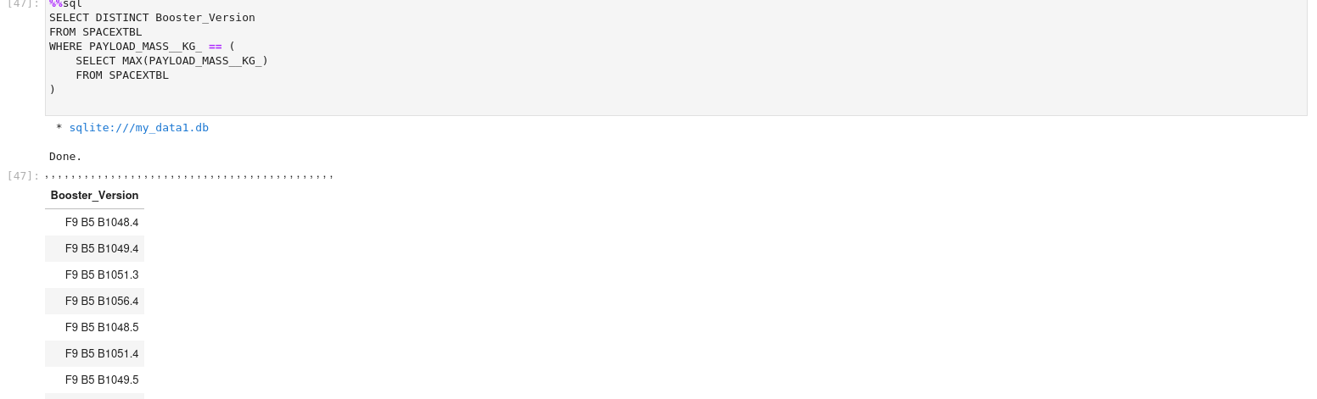
Boosters Carried Maximum Payload
A subquery is used here. The SELECT statement within the brackets finds the maximum payload, and this value is used in the WHERE condition. The DISTINCT keyword is then used to retrieve only distinct /unique booster versions.

Slide 31
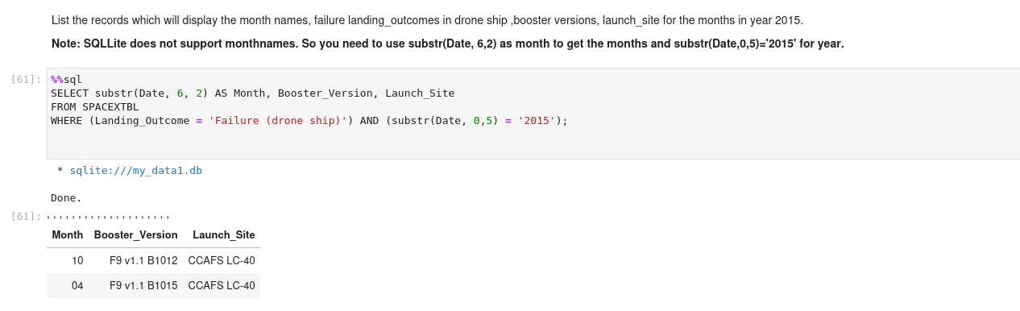
2015 Launch Records
The WHERE keyword is used to filter the results for only failed landing outcomes, AND only for the year of 2015.

Slide 32

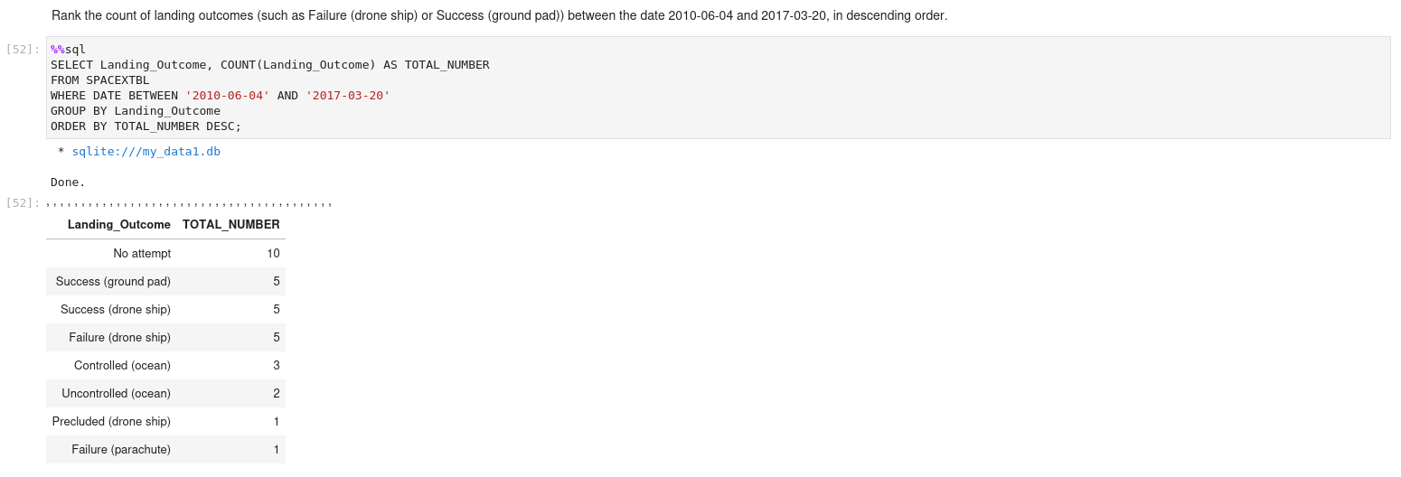
Rank Landing Outcomes Between 2010-06-04 and 2017-03-20
The WHERE keyword is used with the BETWEEN keyword to filter the results to dates only within those specified. The results are then grouped and ordered, using the keywords GROUP BY and ORDER BY, respectively, where DESC is used to specify the descending order.

Slide 33

Section 3

Slide 34
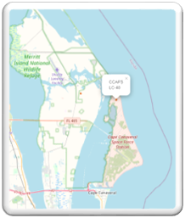
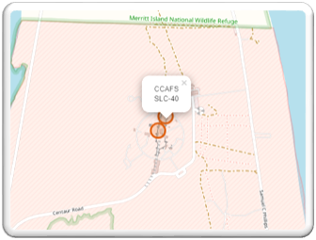
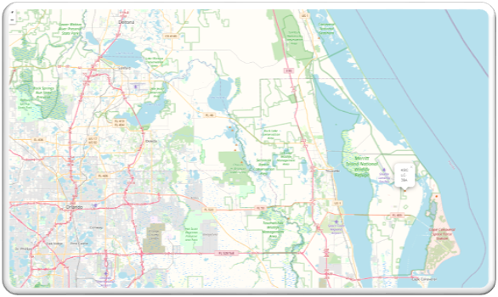

All Launch Sites On A Map
All SpaceX launch sites are on coasts of the United States of America, specifically Florida and California.

Slide 35
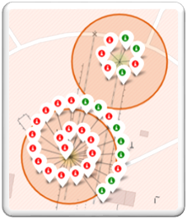
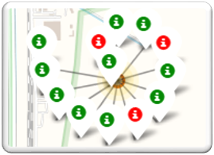
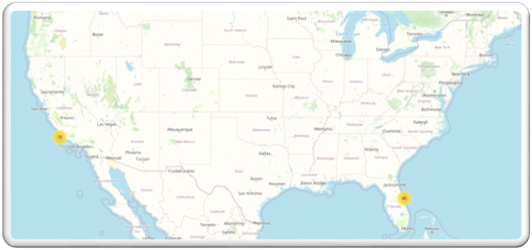
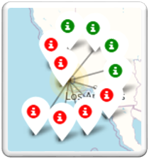
KSC LC-39A
Success/Failed Launches For Each Site
CCAFS SLC-40 and CCAFS LC-40
Launches have been grouped into clusters, and annotated with green icons for successful launches, and red icons for failed launches.
VAFB SLC-4E

Slide 36
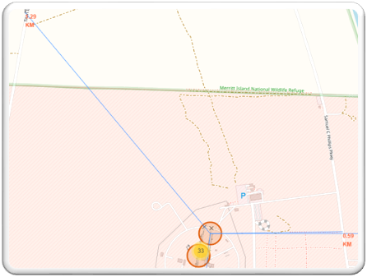
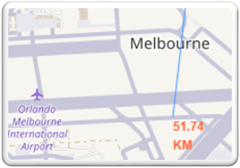
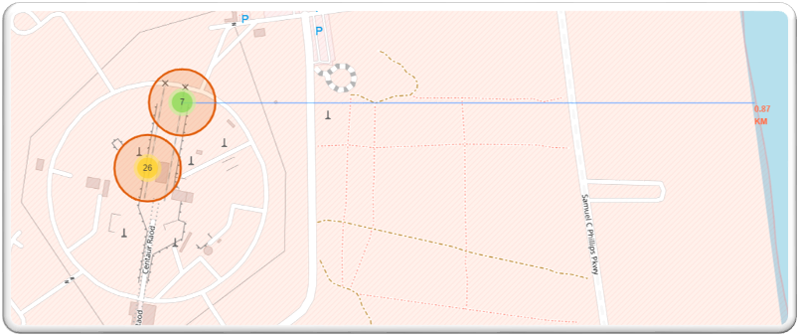
Proximity Of Launch Sites to Other Points Of Interest
Using the CCAFS SLC-40 launch site as an example site, we can understand more about the placement of launch sites.
Are launch sites in close proximity to railways?
YES. The coastline is only 0.87 km due East.
Are launch sites in close proximity to highways?
YES. The nearest highway is only 0.59km away.
Are launch sites in close proximity to railways?
YES. The nearest railway is only 1.29 km away.
Do launch sites keep certain distance away from cities?
YES. The nearest city is 51.74 km away.

Slide 37

Section 4

Slide 38

LAUNCH SUCCESS COUNT FOR ALL SITES
The launch site KSC LC-39 A had the most successful launches, with 41.7% of the total successful launches.

Slide 39
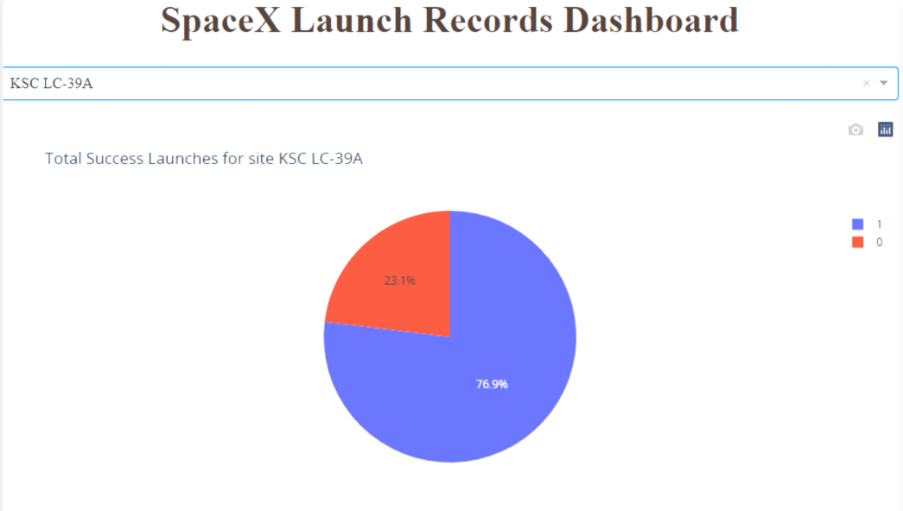
Highest Launch Success
The launch site KSC LC-39 A also had the highest rate of successful launches, with a 76.9% success rate.

Slide 40
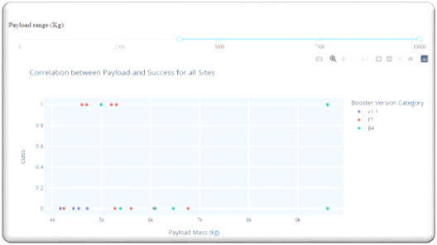
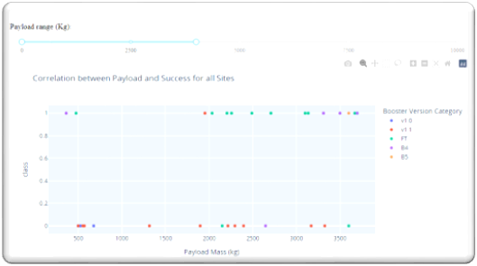
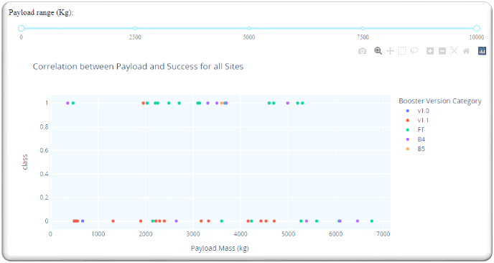
Payload vs. Launch Outcome scatter plot for all sites
Plotting the launch outcome vs. payload for all sites shows a gap around 4000 kg, so it makes sense to split the data into 2 ranges:
0 – 4000 kg (low payloads)
4000 – 10000 kg (massive payloads)
From these 2 plots, it can be shown that the success for massive payloads is lower than that for low payloads
It is also worth noting that some booster types (v1.0 and B5) have not been launched with massive payloads.

Slide 41

Section 5

Slide 42
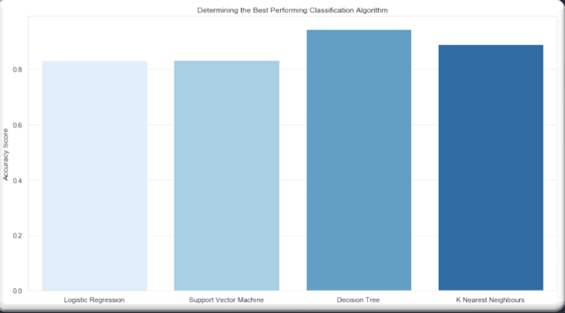
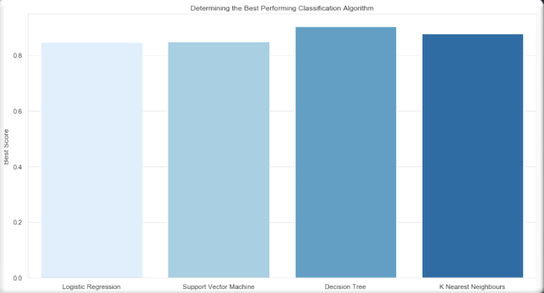
Classification Accuracy
Plotting the accuracy score and best score for each classification algorithm produces the following result:
The decision tree model has highest classification accuracy.
The accuracy score is 94.4%
The best score is 90.3%

Slide 43
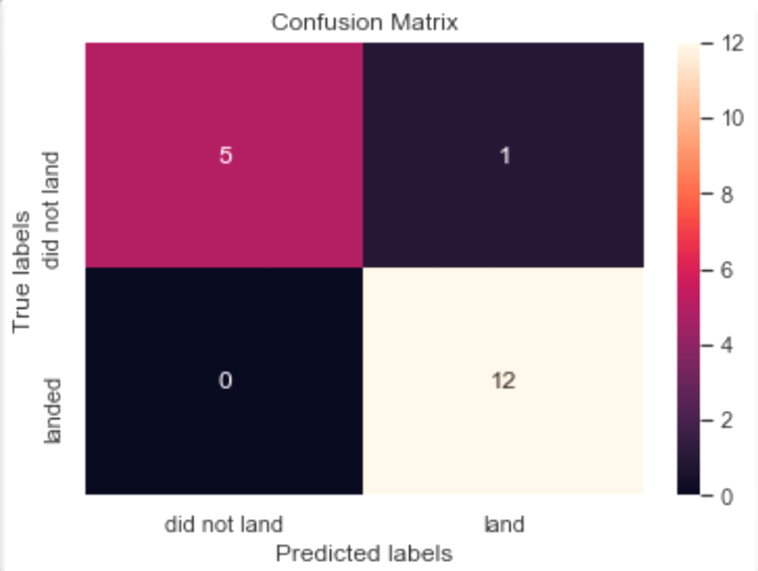
Confusion Matrix
As shown previously, best performing classification model is the Decision Tree model, with an accuracy of 94.44%.
This is explained by the confusion matrix, which shows only 1 out of 18 total result classified incorrectly (a false positive, shown in the top-right corner).
The other 17 results are correctly classified (5 did not land, 12 did land).

Slide 44
Conclusions
As the number of flights increases, the rate of success at a launch site increases, with most early flights being unsuccessful. I.e. with more experience, the success rate increases
Between 2010 and 2013, all landings were unsuccessful (as the success rate is 0).
After 2013, the success rate generally increased, despite small dips in 2018 and 2020.
After 2016, there was always a greater than 50% chance of success.
Orbit types ES-L1, GEO, HEO, and SSO, have the highest (100%) success rate.
The 100% success rate of GEO, HEO, and ES-L1 orbits can be explained by only having 1 flight into the respective orbits.
The 100% success rate in SSO is more impressive, with 5 successful flights.
The orbit types PO, ISS, and LEO, have more success with heavy payloads:
VLEO (Very Low Earth Orbit) launches are associated with heavier payloads, which makes intuitive sense.
The launch site KSC LC-39 A had the most successful launches, with 41.7% of the total successful launches, and also the highest rate of successful launches, with a 76.9% success rate.
The success for massive payloads (over 4000kg) is lower than that for low payloads.
The best performing classification model is the Decision Tree model, with an accuracy of 94.44%.

Slide 45
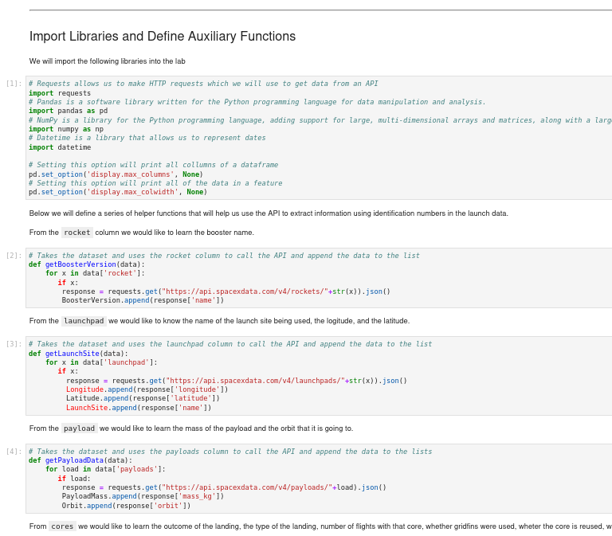
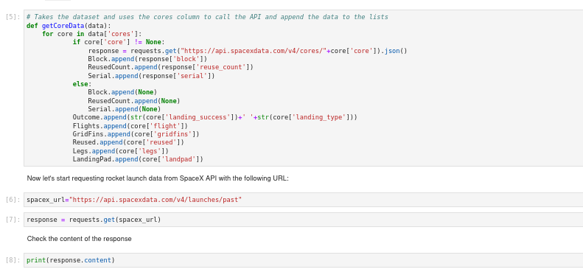
Appendix
Custom functions to retrieve the required information
Custom logic to clean the data

Slide 46
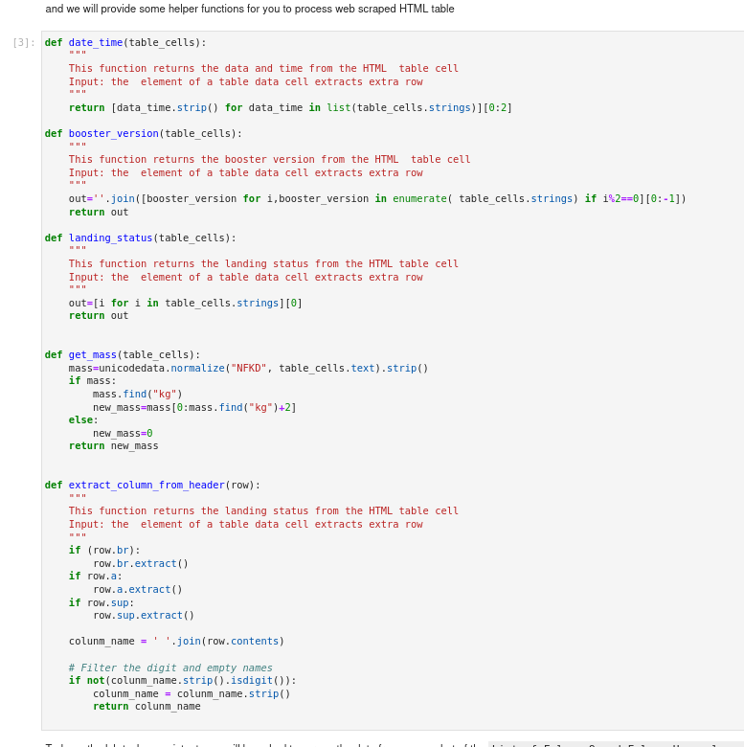
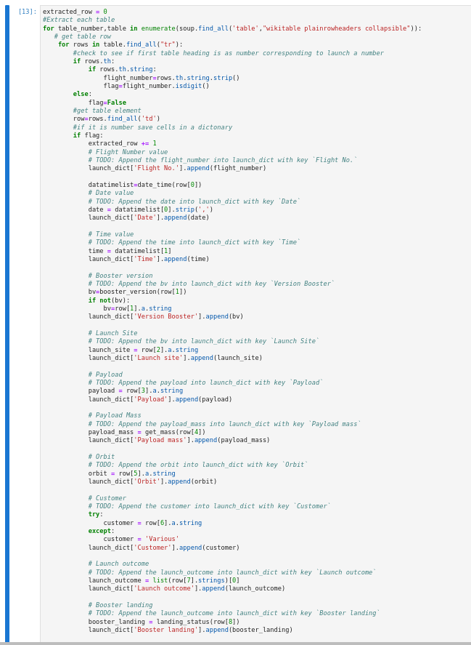
Appendix
Custom functions for web scraping
Custom logic to fill up the launch_dict values with values from the launch tables

Slide 47


